Slide 1
Rockbuster Stealth Data Analysis: Launching Online Video Rental
Rebecca Meyer

Slide 2
Overview of project
Rockbuster Stealth LLC is a movie rental company that previously had stores around the world. To keep up with competition such as Netflix and Amazon Prime, Rockbuster plans to use its existing movie licenses to launch their own online rental service.
The purpose of this presentation is to determine, through data analysis, a strategy for the new online video service.

Slide 3
Questions and objectives
Which movies contributed the most/least to revenue gain?
What was the average rental duration for all videos?
Which countries are Rockbuster customers based in?
Where are customers with a high lifetime value based?
Do sales figures vary between geographic regions?

Slide 4
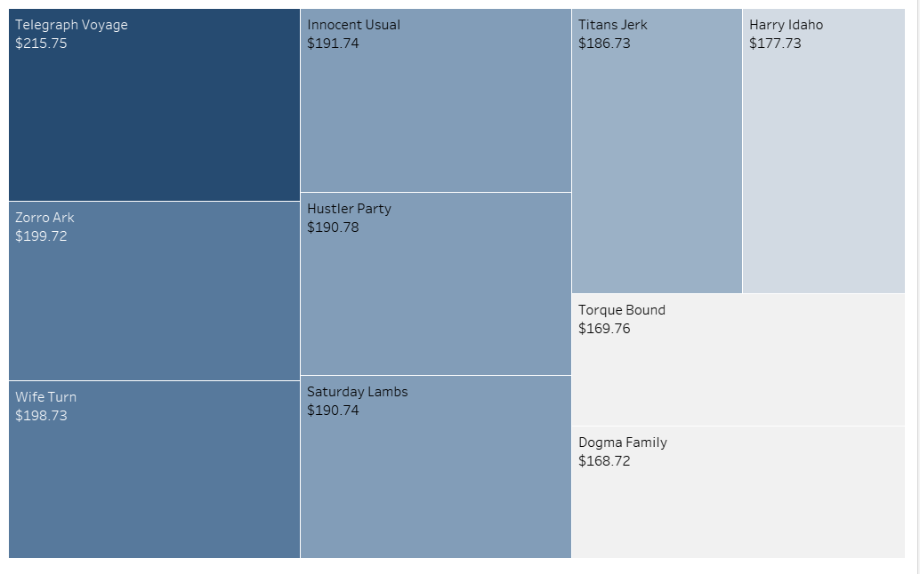
Which movies contributed the most to revenue gain?
These are the top 10 movies that contributed the most revenue, with Telegraph Voyage being the highest earner: $215.75.

Slide 5
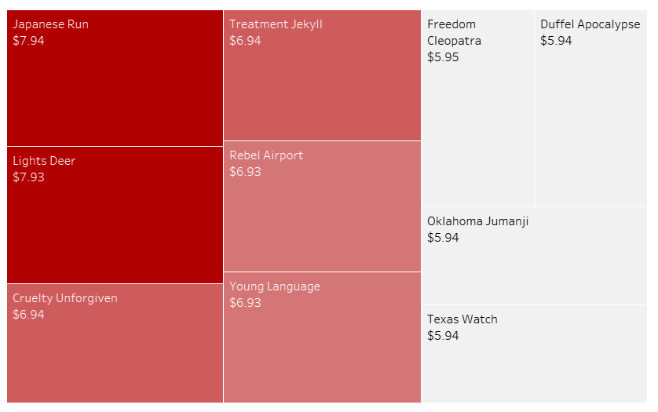
Which movies contributed the Least to revenue gain?
These are the bottom 10 movies, which contributed the least revenue. The bottom three movies all made $5.94:
Duffel Apocalypse
Oklahoma Jumanji
Texas Watch

Slide 6
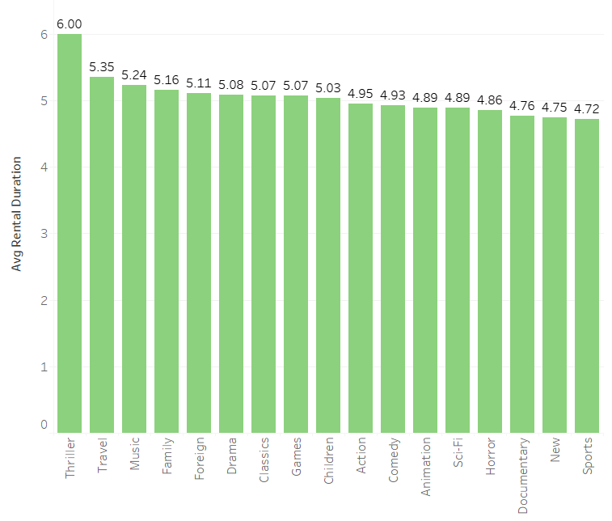
What was the average rental duration for all videos?
The average rental duration for all movies was 4.985 days. In the image on the right, we have also broken out the average rental duration by movie genre.

Slide 7
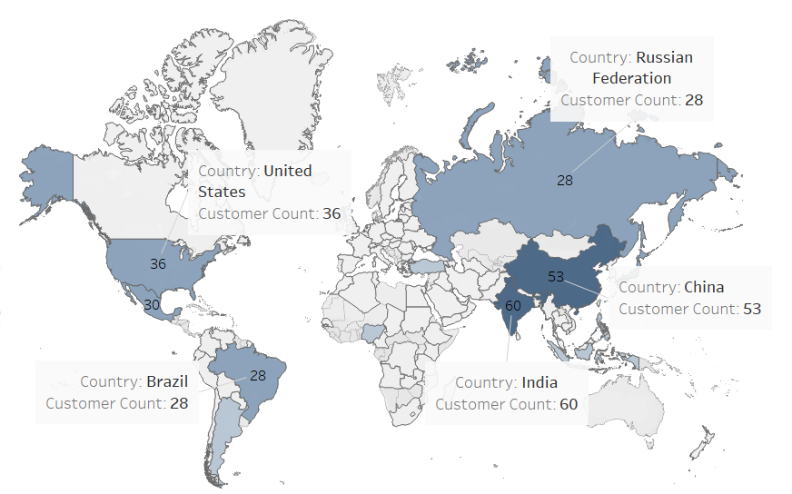
Which countries are Rockbuster customers based in?
Rockbuster Customers are located around the world, but the top countries with the most customers are:
India
China
United States
Mexico
Russian Federation
Brazil

Slide 8
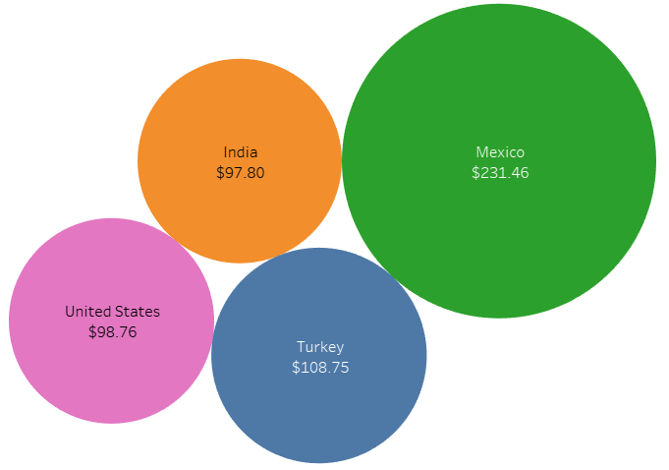
Where are customers with a high lifetime value based?
Customers with the highest lifetime value are located in:
Atlixco, Mexico
Sivas, Turkey
Celaya, Mexico
Aurora, United States
Adoni, India

Slide 9
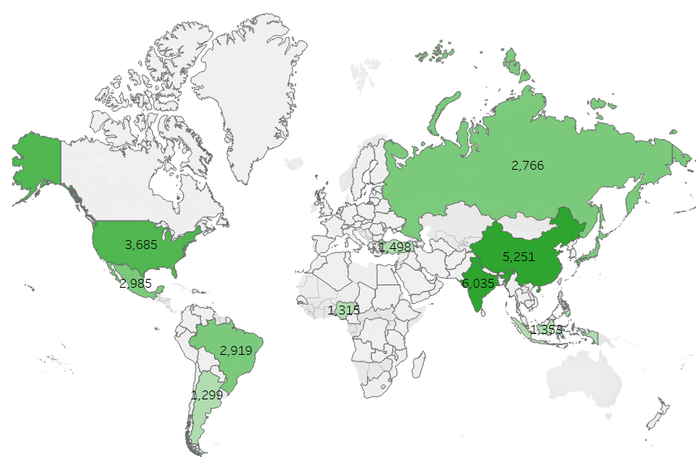
Do sales figures vary between geographic regions?
Yes, sales figures do vary between geographic regions.
India has the highest sales figures at $6,035.
Followed by China with $5,251 and the United States with $3,685.

Slide 10
Conclusion
Through this analysis, we have gained valuable insights into Rockbuster’s top regions, top genres, and best (and least) selling rentals.
Highest grossing movie rental: Telegraph Voyage
Lowest grossing movie rentals: Duffel Apocalypse, Oklahoma Jumanji, and Texas Watch
Most Frequent Rating: PG-13
Average Rental Duration: 4.98 Days
Thriller genre has the highest average rental duration at 6 days
Most customers are located in India, China, United States, Russian Federation, and Brazil
Customers with the Highest Lifetime Value are located in Mexico, Turkey, United States, and India
Highest total payments come from India, China, and the United States

Slide 11
Next Steps and Recommendations
Gain customer feedback via customer survey – why choose Rockbuster over Netflix or Amazon? How to improved moving forward.
Track what users are watching – this will give insight into what continues to be popular. Provide recommendations based on watch history.
Expand reach into different regions – develop marketing budget and strategy.
Expand rental library – have new releases available and expand already existing genre and rental library.

Slide 12
Thank you
Rebecca Meyer
rlwinterisu@gmail.com
Tableau Storyboard: https://public.tableau.com/app/profile/rebecca.meyer5351/viz/A3FinalStory/A3FinalStory?publish=yes

